Slide 1

DATA HARMONIZATION AND
INSIGHTS EXTRACTION
NEXTHIKES IT SOLUTIONS PROJECT 2
~ BY JASPREET KAUR

Slide 2
1
OBJECTIVE
2
3
4
5
PROBLEM STATEMENT
DATASET OVERVIEW
INITIAL OBSERVATION
Data Wrangling Steps

Slide 3

OBJECTIVE:
To resolve ambiguities and inconsistencies in datasets by cleaning, integrating, and extracting actionable insights.

Slide 4
PROBLEM STATEMENT :
Multiple datasets have the following advanced wranglings for accurate analysis:
2
1
3
inconsistencies
missing values
outliers

Slide 5
Dataset_1: Columns: date, season, holiday, working day, weather, etc. Records: [Number of rows]
Dataset_2: Columns: temp, humidity, windspeed, etc. Records: [Number of rows]
Dataset_3: Columns: casual, registered, count, etc. Records: [Number of rows]
DATASET OVERVIEW

Slide 6
INITIAL OBSERVATIONS
1
2
Missing values in weather, temp, and humidity columns.
Inconsistent column formats (e.g., dates).
Issues Identified :
3
Outliers in wind speed and rental counts.

Slide 7


DATA WRANGLING STEPS
TASKS PERFORMED:
1
Merged Dataset_1 and Dataset_2 using the date key.
2
Filled missing values using mean and forward-fill methods.
3
Removed duplicates and unnecessary columns.
4
Concatenated Dataset_3 to the merged data.
5
Handled outliers using the IQR method and capping!

Slide 8
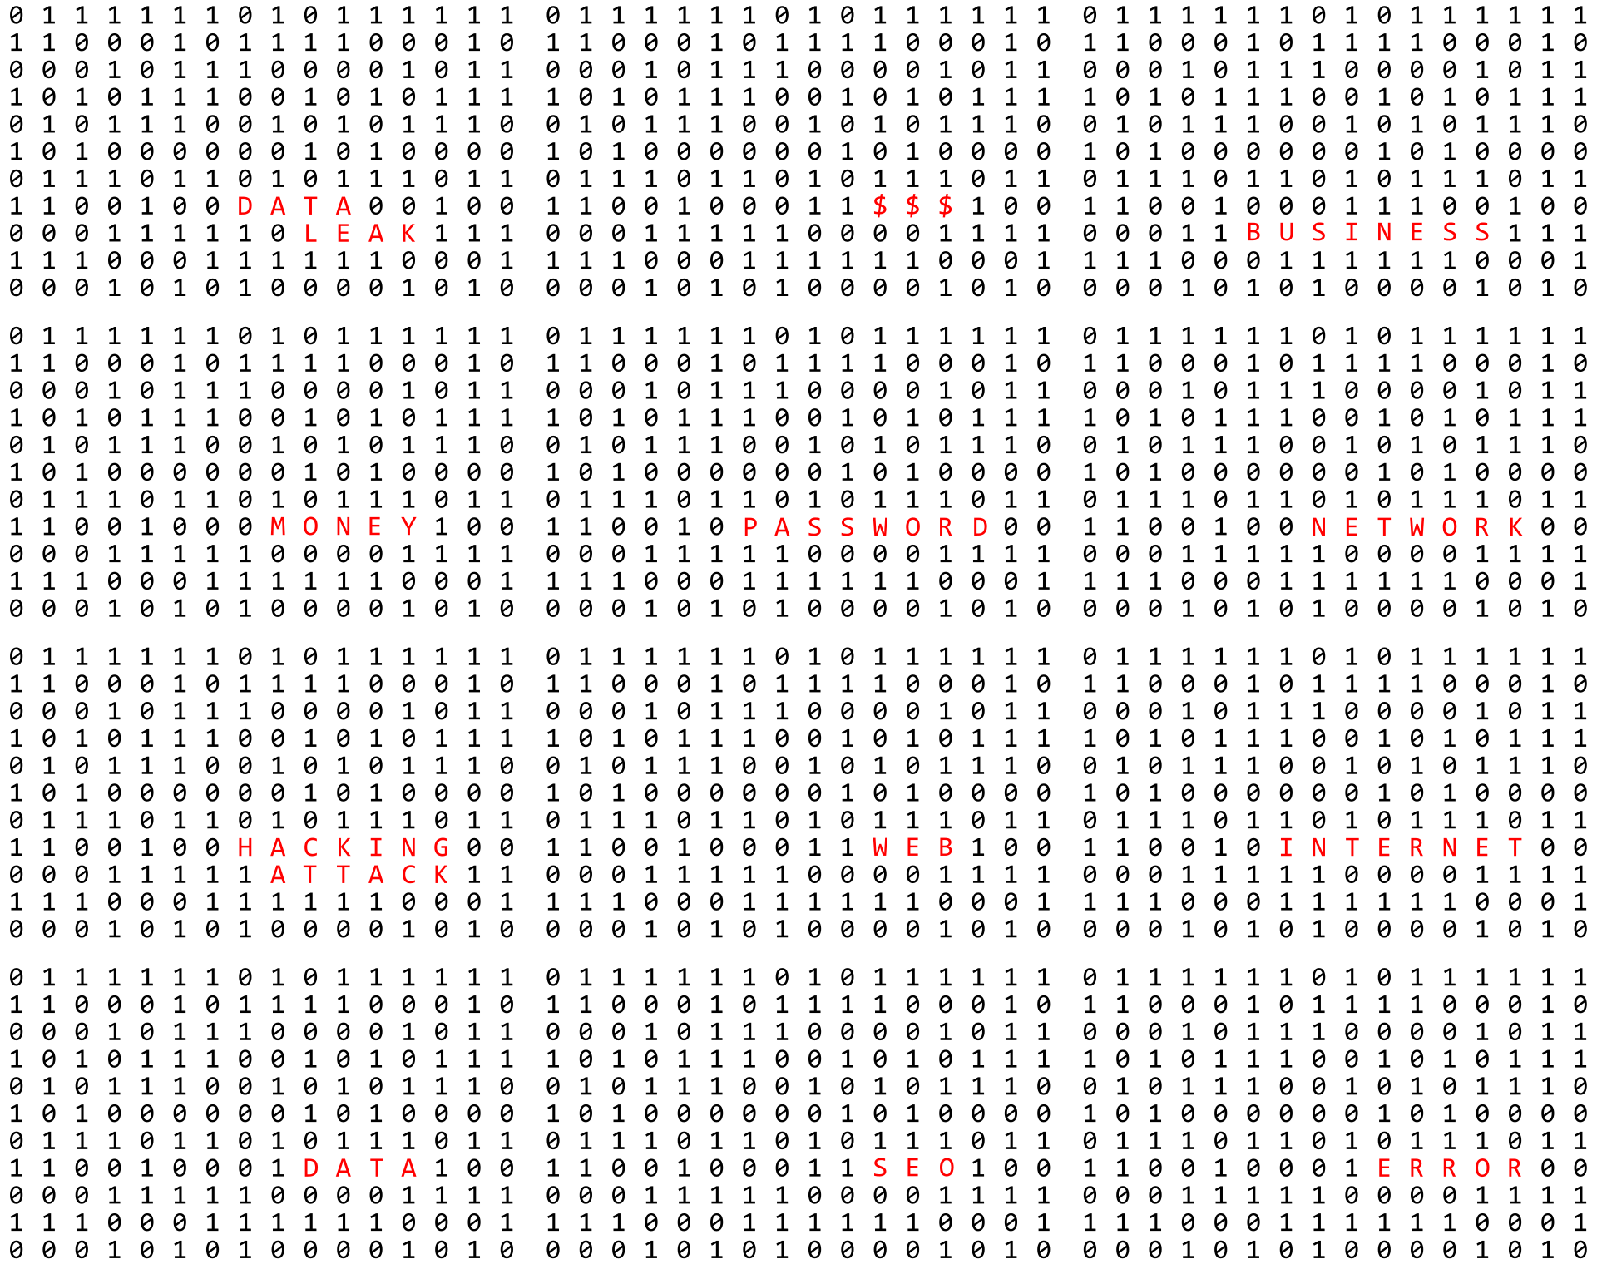
STATISTICAL ANALYSIS
Mean temperature
Average rentals (total)
1
3
2
Median wind speed

Slide 9
KEY INSIGHTS
Seasonal Trends | Weather Impact | Daily Patterns: | Anomalies Resolved:
Summer records the highest number of rentals, followed by Spring. | Rentals are positively correlated with temperature and negatively correlated with humidity. | Holidays see a higher number of casual rentals compared to working days. | Missing data and inconsistencies addressed

Slide 10
CHALLENGES AND RESOLUTIONS
Challenges :
Missing data in atemp (Dataset 2).
Merging and aligning Dataset 3 due to structural differences.
Identifying and addressing duplicates.
Resolutions :
Imputed missing values systematically.
Realigned columns before concatenation.
Validated through statistical checks and visualizations.

Slide 11

CONCLUSION
Successfully harmonized three datasets into one unified dataset.
Addressed missing values, inconsistencies, and anomalies.
Gained actionable insights about seasonality, weather effects, and rental behavior.
Prepared dataset for advanced analysis and business use cases.

Slide 12

THANK YOU

